Slide 1
‘Natural Capital’ – A better term than ‘Natural Resources?’
Third Country Training Programme TCTP2017
Title of course: Integrated Biodiversity and Ecosystem Conservation Training Course
This seminar aims to provide an intellectual framework for the monetary evaluation of natural resources, hopefully leading to more sustainable management
Why Natural Capital and not Natural Resources?
Note: This is Power Point is designed for you to take back with you and study later

Slide 2
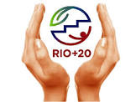
‘Rio + 20’ was the original source of this seminar content
The United Nations Conference on Sustainable Development - or Rio+20 - took place in Rio de Janeiro, Brazil on 20-22 June 2012. It resulted in a focused political outcome document which contains clear and practical measures for implementing sustainable development. https://sustainabledevelopment.un.org/rio20.html
The Conference also adopted ground-breaking guidelines on green economy policies. It triggered development of a set of Sustainable Development Goals (SDGs)
It also galvanized the attention of thousands of representatives of the UN system and major groups. It resulted in over 700 voluntary commitments and witnessed the formation of new partnerships to advance sustainable development.

Slide 3
The Gabarone Declaration
Gabarone Declaration for Sustainability in Africa
An African-led initiative for sustainable development (May 2012)
“To ensure that the contributions of natural capital to sustainable economic growth, maintenance and improvement of social capital and human well-being are quantified and integrated into development and business practice.”
This Declaration actually preceded the Rio+20 conference. All credit to these African nations
With thanks to participants from Botswana, Peggy Kedikilwe Tsalano & Babitseng Thamani Meshack, for alerting me to this on Thursday
1st use of the Natural Capital concept in a major policy statement?

Slide 4
Natural Capital? – New way of thinking about use of
natural resources
….think…moving towards sustainability from unsustainability
.....think …..moving towards renewability from non-renewability
…..think ……a fundamental fact of life on earth is that:
at some point a balance will be reached between human needs for resources to sustain life for 7 to n (maybe n=10?) billion people and the ability of the planet to provide these.

Slide 5
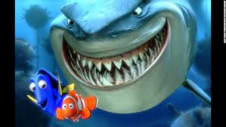
….at some point,
without a shift to sustainability in using natural resources, the human population of the planet will be reduced (‘Nature Bites Back’)
Humanity
Nature
– a traumatic procedure at the human experience level – but normal operating procedure by Nature when the carrying capacity of a species exceeds resource limits. Think of budgerigars in Australia’s wet & dry climate cycle

Slide 6
Most people’s way of thinking when they hear the phrase ‘Natural Resources’ is to think of taking away something for human use. Could be non-living resources like coal, oil, or living resources like timber, fish Or to take for granted clean air and water There is too little consideration for non-living resources - of managing the stock for the long term; e.g Britain’s discovery of oil in the North Sea (between Britain & continental Europe) the 1970’s. The oil was exploited as fast as it could be pumped out. Big loss of future income as a result

Slide 7
Important point
Non-living resources are by definition unsustainable, they cannot reproduce themselves
If used wisely or if the reserves are enormous, they can benefit a country for centuries (or more)
Some oil and gas executives say that the amount of natural gas in the earth’s crust is so enormous that in effect if will never all be used. This is partly due to the increasing cost of extracting it
But as new technologies are developed (e.g. shale gas extraction) surprisingly large reservoirs can be tapped
Technofixes have a future, but a limited one. Not to be relied upon

Slide 8
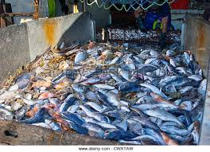
In the case of living resources, many are managed sustainably, (farming)(aquaculture) by breeding (young animals or plant seeds)(sustainable harvesting)
However there is a very big problem with many living resources being harvested unsustainably e.g. most marine fish stocks
This degrades biodiversity and challenges the very existence of some ecosystems. Coral reefs around Sabah are so extensively damaged by high temperatures, fish-bombing and trawling that it is a problem to find healthy ones except in protected areas

Slide 9
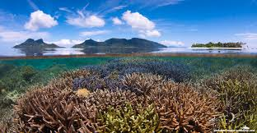
Pristine coral reef off Semporna, East Coast of Sabah,
Malaysian Borneo

Slide 10
Unsustainable Use of Resources I am sure you know of many examples from your own countries. You may want teaching tools to get the message across to government & civil society that unsustainable harvesting leads to permanent loss of biodiversity & ecosystems, meaning less ability to provide humanity with resources for its well-being – and ultimately its existence. It is an existential problem
Here is a tool for teaching whoever it is you need to persuade about conservation and wise use of natural resources (of particular value with policy-making economists)
First, switch to talking about ‘Natural Capital’
Define it as: The value in USD, rand, baht or ringgit of natural resources– be it iron ore, timber, water, sunshine (sunshine nowadays can be priced by the value of electricity it can produce via solar panels)

Slide 11
Once you use the value approach you can compare natural capital with financial capital & human capital in value
Financial capital – cash; stocks; property (houses, land), valuable artefacts (jewellery, paintings), mechanical artefacts (cars, airplanes)
Human capital – education, experience; specialist knowledge (Dubai now trying to recruit all kinds of specialists (master chefs, master printers, expert code writers, university professors) to work there)
Natural Capital - What the planet has in the way of natural resources
Non renewable Natural Capital needs to be ‘spun-out’, ‘husbanded’, i.e. some kept in reserve
Renewable Natural Capital needs to be harvested sustainably

Slide 12
Keyword Definitions
Natural Capital
Natural resources that are managed to provide goods & services for societies.
NatCap includes fossil fuels & minerals
But, except on a geological timescale (100’ of millions of years) stocks of fossil fuels & minerals are finite (no replacement)

Slide 13
Natural Income e.g. like interest in money from a bank savings account
The portion of natural capital (resources) that is produced as interest, i.e. the sustainable income produced by renewable natural capital
Even if all of this interest is consumed, the capital is not reduced. e.g in sustainable fishing for tuna, the population after the harvest would be the same size (or bigger if lightly harvested) than before

Slide 14
Natural Capital
Total Economic Value
Total Economic Value
Use Value
Non – use value
Direct
Use Value:
Consumptive
Non-consumptive
Indirect use
value
Optional Value
Option
Bequest
Existence
Value

Slide 15
A terminology swamp – alternative terms
Natural Value – that part of Natural Capital which can currently be quantified in USD value
Economic Value – the market price of the goods and services a resource produces. Has to be responsibly calculated – no arm waving
Ecological Value – Resources with no formal market price: soil erosion control, nitrogen fixation and photosynthesis are all essential for human existence but have no direct monetary value, although some estimates have been made

Slide 16
…. back to diagram… Natural Capital
Total Economic Value
Total Economic Value
Use Value
Non – use value
Direct
Use Value:
Consumptive
Non-consumptive
Indirect use
value
Optional Value
Option
Bequest
Existence
Value

Slide 17
use
Use
Direct values:
Outputs that can be consumed directly, such as timber,medicines, food, recreation, etc + fossil fuels & minerals
Indirect values:
Ecological services, such as flood control, storm protection, carbon sequestration, climatic control, etc
Option values: the premium placed on maintaining resources for future direct and indirect uses, some of which may not be known now e.g the rare earth metal lanthanum
Easy to value Not easy to value

Slide 18
Non-use values, also known as ‘existence values’
Existence values: the intrinsic (‘built-in’) value of resources, e.g. cultural, aesthetic, adventure “Because its there”.
Mt Kinabalu is a tourist goldmine, but it is far, far more than that e.g. genetic diversity storehouse, spiritual icon, aesthetic (beauty), adventure playground

Slide 19
Non-use Values continued… Option value (bequest) could also be included here in part:
Supposing you have a house looking down on a beautiful peaceful forested valley. You decide to keep it for your children:
It has a ‘Use’ bequest value because your kids could chop down the forest and live off the proceeds
It also has a non-use existence value because in chopping down the forest the aesthetic value of the valley may be lessened – particularly if the little horrors build a factory in full view e.g. hill towns in central Italy with factories below

Slide 20
Tips on assessing natural capital (1)
Direct use values are natural goods and services that are directly used by humans – most often by people visiting or residing in the ecosystem
Consumptive use values include harvesting food products, timber for fuel or housing, medicinal products and hunting animals for food and clothing, copper mining in the case of Mt K
Non-consumptive use values include recreational and cultural activities that do not require harvesting or ‘mining’ of products. Golf course in the case of Mt Kinabalu
Indirect use values are derived from ecosystem services that provide benefits outside the ecosystem itself (e.g. natural water filtration, which may benefit people downstream)

Slide 21
Tips on assessing natural capital (2)
Optional values are derived from the potential future use of ecosystem goods and services not currently used – either by yourself (option value) or for future generations (bequest value)(keeping some resource for your children’s benefit) e.g. a forest
Non-use values include intrinsic and aesthetic values. You like it – and want to keep it for ever – just because it exists. Hence these also called existence values. These values have no market price
There are many attempts to value nature so that its importance to humanity can be objectively assessed.
What, for example, is the cost to a sovereign country of the loss of its biodiversity? What is the value of the countries Natural Capital compared with its Financial and Human Capital
However, in most cases these valuations of Natural Capital are not precise.
For example Mt Kinabalu in Sabah has a phenomenally high level of biodiversity and loads of endemic species. It has pristine forest, spectacular waterfalls, challenging climbing to 4,000m, strong spiritual value and is the pride of all Malaysia. But the only truly objective value that can be placed on this is tourist dollars (note: ‘endemic’ means occurs nowhere else on the planet)

Slide 22
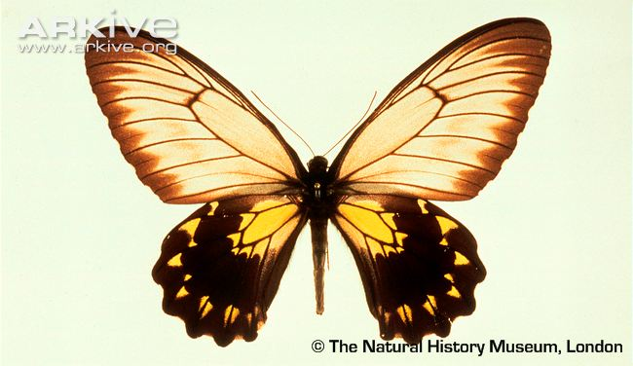
Troides andromache, the endemic Kinabalu Birdwing butterfly Wingspan 17cm (6 inches). What cost if goes extinct?

Slide 23
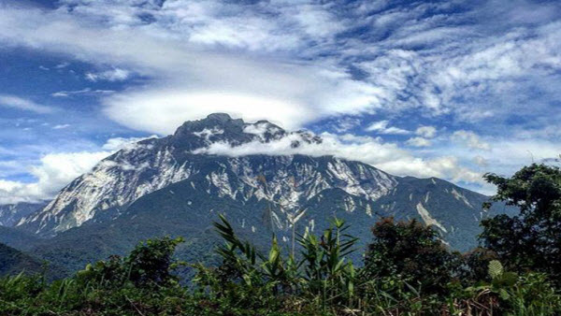
Trade offs between consumption and biodiversity loss
On Mt Kinabalu building the golf course on the Mesilau Plateau at 1800m resulted in the loss of a large area of pristine montane forest, with consequent great loss of biodiversity (including the birdwing - but OK elsewhere on the mountain)
On Mt Kinabalu the copper mine created wealth in USD (most of which went overseas) but resulted in forest loss and toxic dust from dried out waste lagoons near the villages below when mining finished

Slide 24
Calculating values
Direct and indirect values can be quantified, more or less
Option values and non-use values are nearly impossible to quantify, but should not be ignored.
For example, even an economist would have to accept that although the spiritual/aesthetic/inspirational/ ‘re-charging of batteries’/adventure value of some places or ecosystems may be impossible to quantify, they are highly valued by individual humans or groups. Therefore their value should definitely not be ignored.
Waterfalls the world over are sought out for visiting. Mt Fuji, Mt Kinabalu, Mt Kilimanjaro; Uluru. All have spiritual, ethical, philosophical values.
All these places make tourist dollars, but would be revered without those

Slide 25
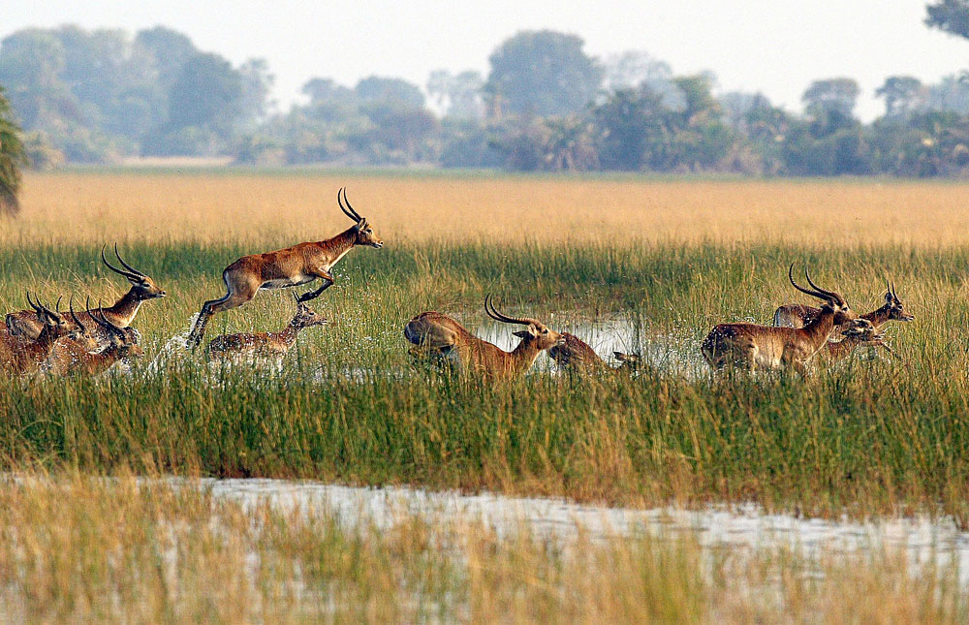
Also national pride – Okavango Delta (Africa’s last Eden)

Slide 26
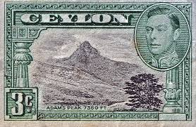
….. And Sri Lanka’s Sri Pada or Paada (‘Sacred Footprint’ of Buddha)
Great religious significance to many cultures, even Christianity.
I still have this stamp in my childhood stamp collection

Slide 27
Some Key Points (I believe in repetition!)
Resources are everything that is useful to mankind. Non-renewable resources (oil, coal) generate wealth but can be used only once in a human lifetime
Natural Capital and Natural Resources are often substituted for each other
However Natural Resources suggests that resources are there to be used,
Whereas Natural Capital suggests something to be managed to produce an income or a return on the investment. Sustainable. People can live off the interest
They include air, water, soil, people, education, fossil fuels, ecosystems and so on

Slide 28
Valuing Biodiversity – a Malaysian example
Biodiversity is difficult to value, but there is no doubt Malaysia values it. MYR2.6m has recently been granted to Bring back Malaysia’s National Heritage from Overseas
(‘National Heritage’ is anything a nation values – human artefact or natural capital)
In this case it is to bring back digital images of type specimens of plants & animals from the museums of the ex colonial occupiers – in Malaysia’s case this is the UK.

Slide 29
Repatriation by digital means of part of Malaysia’s biodiversity: The ‘Repat’ Grant
Type specimens of species are the key to knowing how much animal & plant diversity Malaysia has
These days no need to bring back the type specimens themselves, can repatriate 3D digital images & DNA bar codes, then create a Malaysian Natural History Museum in Kuala Lumpur to provide a place to study them and educate the public about this valuable part of Malaysia’s Natural Capital
The funding is for (among others): image capture of the type specimens in London & export to M’sia
Training of a new generation of Malaysian taxonomists and employing them to study and analyse
Training of museum curators, rangers and tour guides to educate the public about the value of biodiversity as a national asset as part of its Natural Capital.
Hasanah Foundation - driving for sustainability & awareness
Apply pressure get a similar foundation started in your own country!

Slide 30
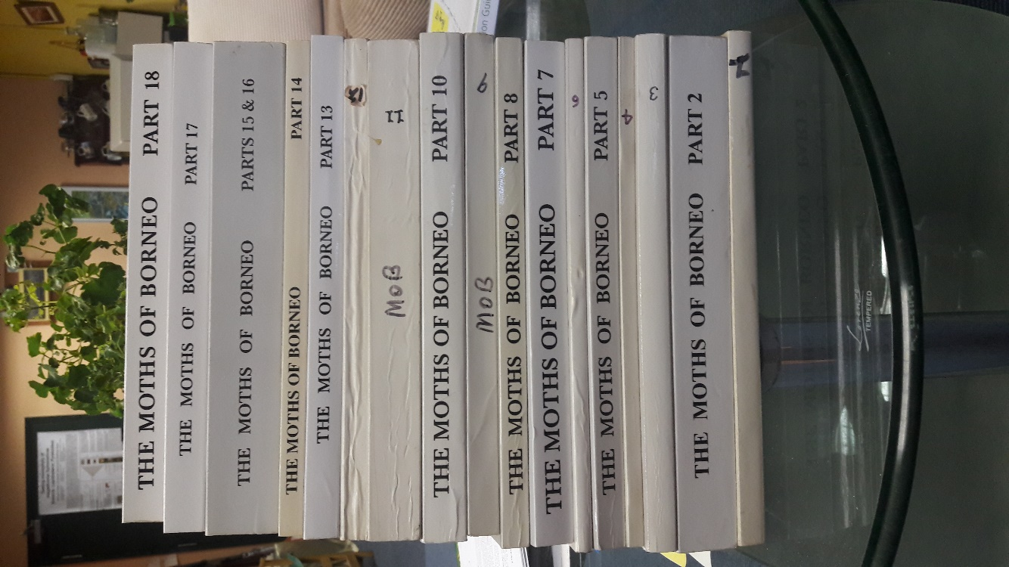
Moths of Borneo (macros - larger moths)
18 Parts, 4,000+ pages, 4,000 + species written up and imaged
Many new species
Completed in 2011, since when many more species have been found.
30 years in preparation
Privately sponsored throughout, but in part publicly now

Slide 31
Pyraloid Moths of Borneo (PoB)
This research programme benefiting from a grant (from July 2017) to complete the work on PoB with the publication of 3 printed volumes of moth images and a website.
Auditing of pyraloid moth biodiversity shows 2,300+ Malaysian Borneo (Sabah & Sarawak). Megadiverse hotspot on world scale
New development in taxonomy developed for PoB is hybrid publication
Printed volumes of high quality images + a QR code for each species image
QR codes link to a massive website, each species entry has 11 tabs (‘pages’)
Images imported from London’ Natural History Museum are a key feature

Slide 32
Pyraloid Moths of Borneo (continued)
SE Asia reference collection of set specimens collected in Sabah in Borneensis Museum here in ITBC.
Will bring in researchers from S & E Asia to study the collection. Appreciation of its value will re-inforce conservation pressure for the habitat from which most species come from – rain forest
Will also be linked to website by QR codes (but at present no signal at UMS! ) http://stephensutton.info
Appbooks. The are small digital books (c. 24 pages) with extracts from the website or instructional material about e.g. studying moths or the importance of rainforest to conserve their diversity

Slide 33
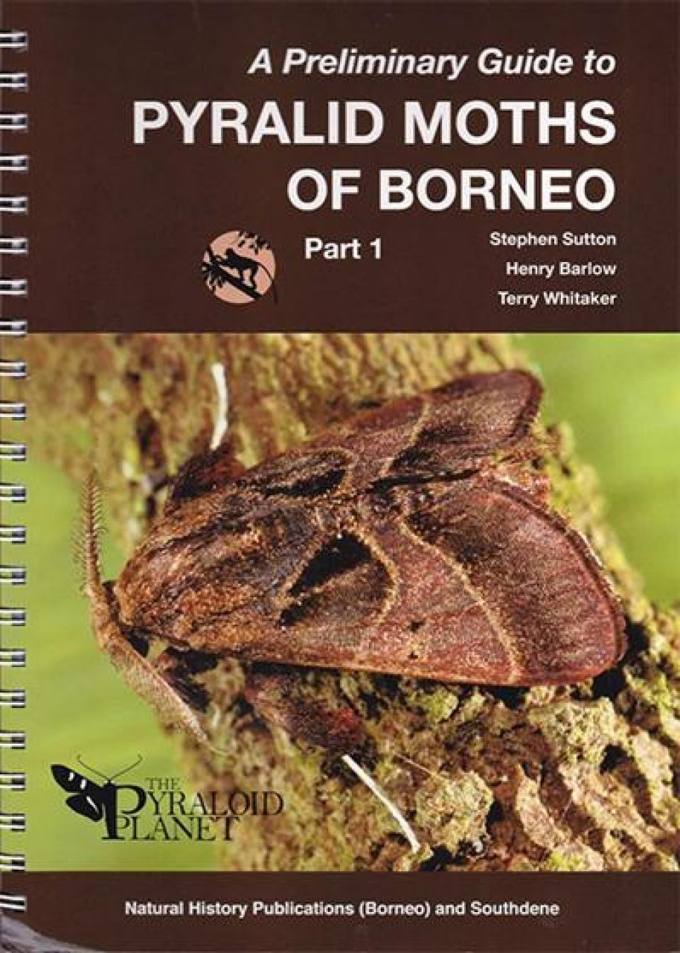
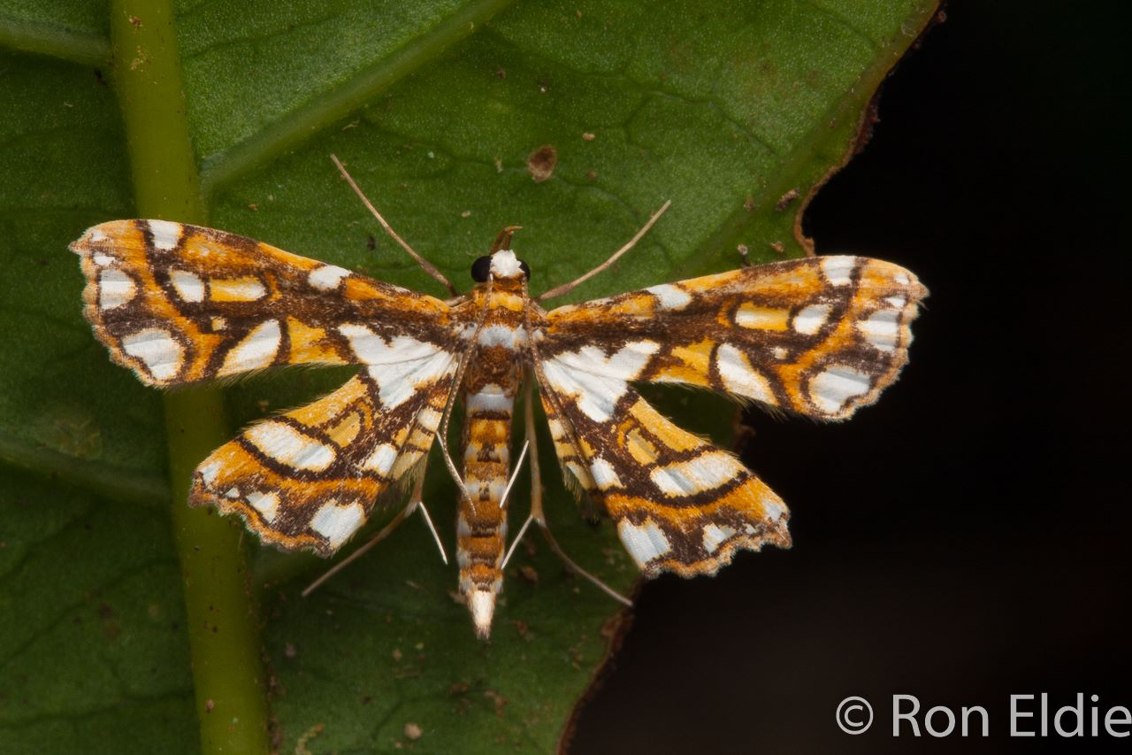
2,300 species, 40% new 3 Volumes. Started 2003 Pyraloid Moths of Borneo Website

Slide 34
Significance of the ‘Repat’ grant
The size and wide distribution of the grant, including to an overseas institution (the Natural History Museum in London) indicates a welcome drive for study leading to wise management of Natural Capital in Malaysia.
Shows deepening maturity in environmental policy as the country approaches year 2020
This is the year M’sia aims to become a Developed Nation.

Slide 35
Sources
https://www.amazon.com/Environmental-Systems-Societies-Diploma-Revision/dp/147189973X
Environmental Systems and Societies IB Diploma Study Revision Guide: Second edition. Andrew Davis & Garrett Nagle.
This is an excellent condensed summary guide from which this seminar is derived. 174 pages
https://www.amazon.com/ENVIRONMENTAL-SYSTEMS-SOCIETIES-International-Baccalaureate/dp/1447990420/
ENVIRONMENTAL SYSTEMS AND SOCIETIES (ESS) STUDENT EDITION TEXT PLUS ETEXT 2ND EDITION (Pearson International Baccalaureate Diploma: International Editions) 2nd Student edition Edition. Andrew Davis & Garrett Nagle.
The full book of which the Revision Guide above is a summary
Source of Borneo/Sulawesi insect biodiversity papers
Stephen Sutton’s website with news of insect biodiversity studies in Borneo and his publications

Slide 36
Sources cont.
Pyraloid Moths of Borneo Identification Website
An example of the ongoing auditing of Sabah’s mega-biodiversity. It is an example of hybrid publishing. The website is associated with a series of 3 volumes of images (1 published, 2 to come). Each image is of a different species and is linked by a QR code directly to the write-up for that species on the website. There is no need to log-in to the site. The connection is immediate if there is good broadband. The books consist only of images and their QR codes. On the site each species has 11 tabs (‘pages’). Printing is expensive, website content, once set up, is almost without cost. This project is privately & publicly sponsored.
Borneo’s biodiversity is increasingly well documented due to ongoing auditing in Sabah & Sarawak and active publishing of nature guides e.g. Books on Borneo Biodiversity

Slide 37
Finish! And thanks for listening!

